Slide 1

Lead Scoring CASE STUDY
Submitted by –
Ankita Gupta
& Satish Chowdary
(Batch - DSC43)

Slide 2
Index
Problem Statement
Approach
EDA and Univariate/ Bivariate Analysis
Overall Approach
Conclusion
Final Recommendation

Slide 3
Problem Statement
X Education Company is an education company which sells Online Courses to professionals. Marketing of the company is done via several websites and search engines. When people land on the website and fill up a form for enquiry, they are classified as lead. Sales Team approach to these leads for sale of their product (conversion).
Current Lead Conversion Rate of the company is 30% and company intends to increase the Conversion rate to 80% by identifying “Hot Leads” which has comparatively high probability for conversion.
Now there is 1 dataset provided, which contains details of around 9000+ leads on 37 features.
We have following Goals as a Data Analyst -
Build a logistic regression model to assign a lead score between 0 and 100 to each of the leads which can be used by the company to target potential leads. A higher score would mean that the lead is hot, i.e. is most likely to convert whereas a lower score would mean that the lead is cold and will mostly not get converted.
There are some more problems presented by the company which your model should be able to adjust to if the company's requirement changes in the future so you will need to handle these as well.

Slide 4
Approach
Following is the step-by-step approach which is used to analyze the dataset and draw the inferences based on the findings. There are multiple ways to approach a problem and the approach which is used in this assignment is one of the ways to solve the problem. Same Steps are also followed in the Python file attached.
Import Libraries and Data source
EDA – Exploratory Data Analysis
Handling NULL Values
Converted “Select” values to Null wherever applicable
Removed Columns where null value is greater than 45%
Removed Rows where null value is less than 2%
Imputed values based on data available, wherever necessary
Column Selection
Removed Columns where single value available across all data points
Removed Columns where there was high data imbalance >85%
Removed Redundant Columns from the dataset

Slide 5
Approach contd.
Univariate / Bivariate Analysis
Standardizing categories with multiple values
Combining multiple categories as single category which are contributing very miniscule in a feature
Handling outliers in the dataset
Data Preparation for Modelling
Conversion of Categorical Binary variable to 1/0
Dummy Variable Creation for categorical columns
Train and Test Split
Feature Scaling
Train Dataset as fit_transform
Test Dataset as transform
Correlation in Features
Model Building – Logistic Regression
Model Building based on p-value and VIF value
Parameter tracking – Confusion Matrix, Accuracy, Recall, Precision, Specificity, False Positive Rate, Negative Predictive Value, etc.

Slide 6
Approach contd.
ROC Curve
Optimal Cutoff Point
Precision Recall Curve
Predictions on Test Set
Final Train v/s Test Set Comparison on Parameters

Slide 7
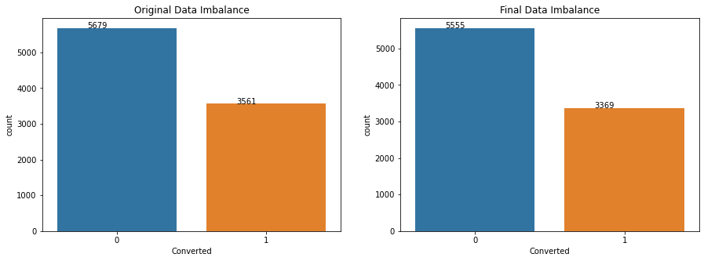
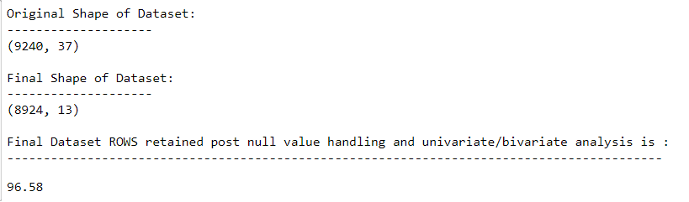
EDA – Data Imbalance and Shape
Data Imbalance Ratio
Data Set Shape
0 implies Converted
1 implies Not Converted

Slide 8
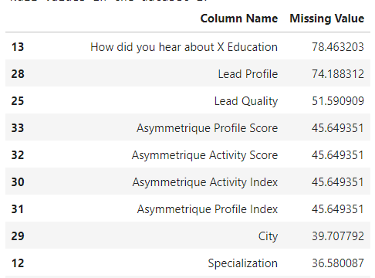
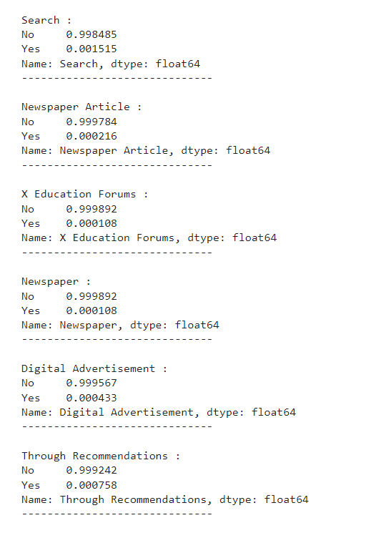
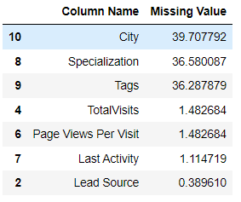
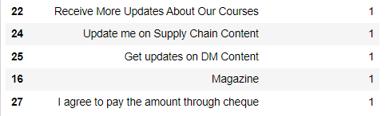
EDA – Null Value Handling and Column Selection
Columns with high Data Imbalance are also removed
Columns with intermediate missing Values are imputed based on the data understanding
Columns where Null Val is >45% are removed
Columns with same value across all data points are removed
Columns where missing Values are <2%, those rows are removed

Slide 9
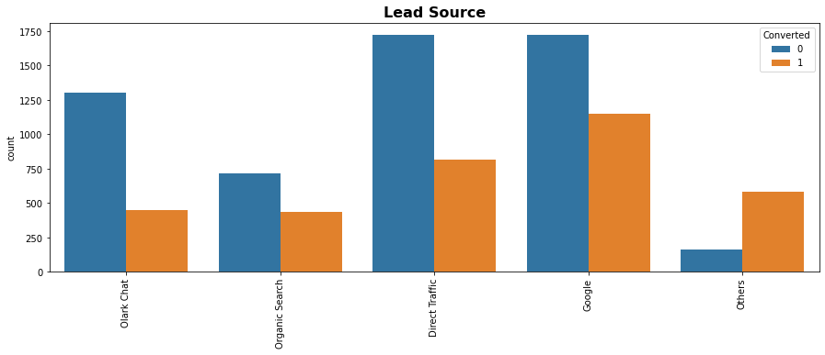
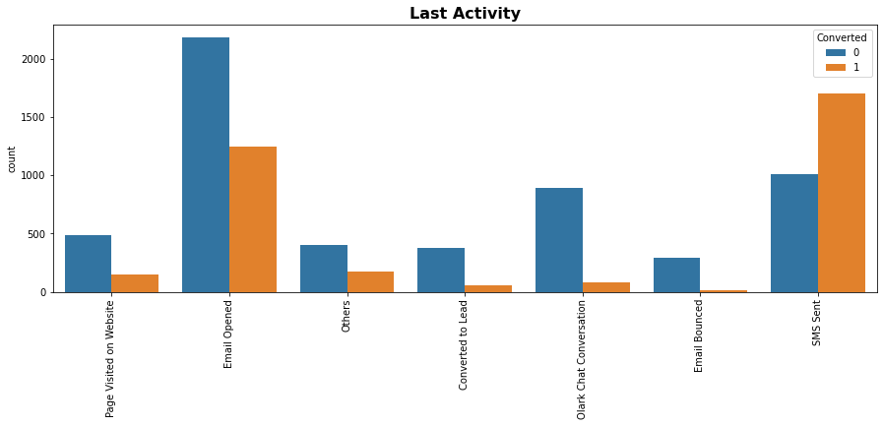
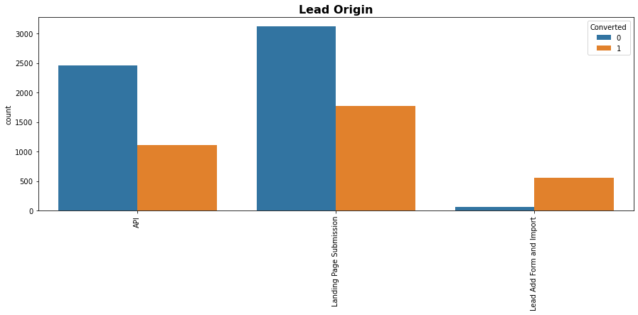
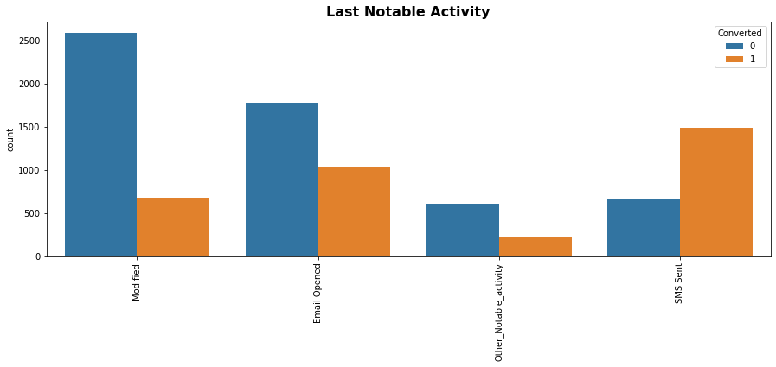
EDA – Univariate/ Bivariate Analysis and Final Column Selection

Slide 10
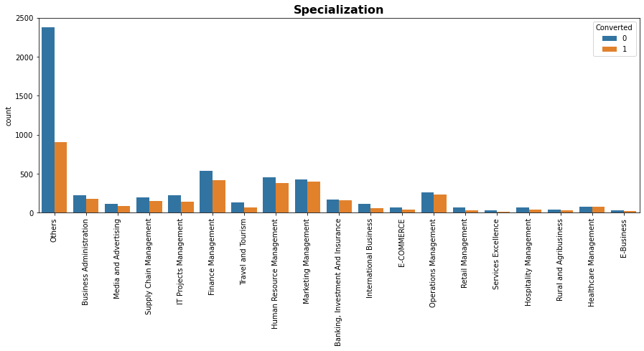
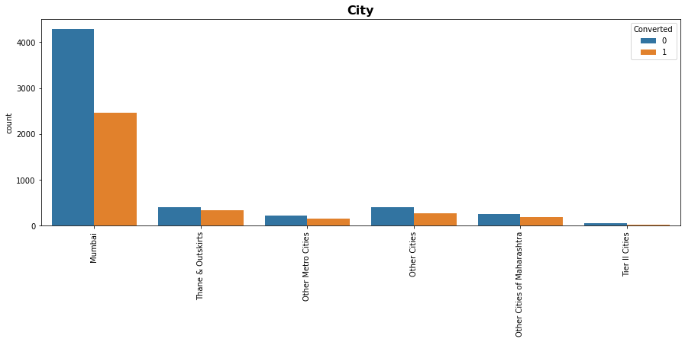
EDA – Univariate/ Bivariate Analysis and Final Column Selection

Slide 11
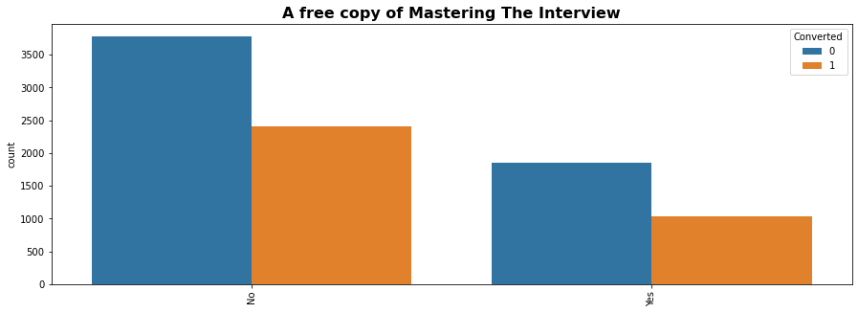
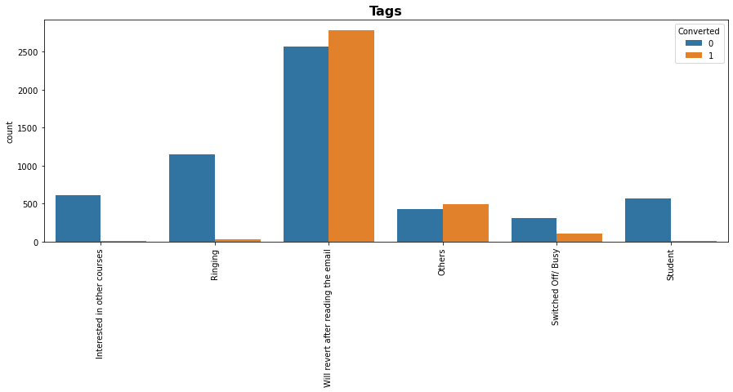
EDA – Univariate/ Bivariate Analysis and Final Column Selection

Slide 12
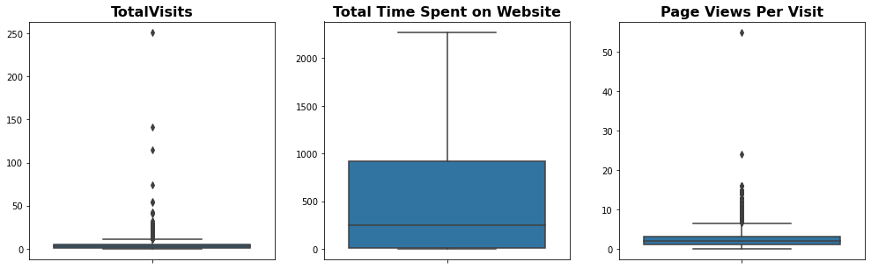
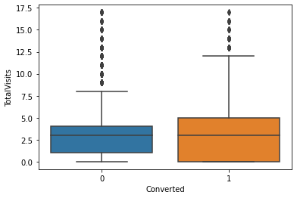
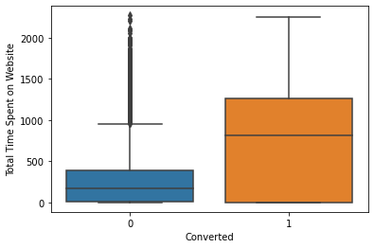
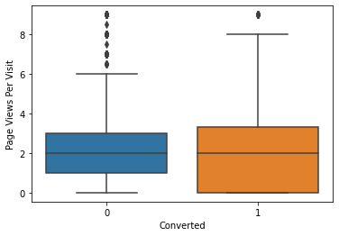
EDA – Univariate/ Bivariate Analysis and Final Column Selection
1
11
1 implies Analysis of Numeric Variable
11 implies Analysis of Numeric Variable post outlier treatment, in respect to Converted/Non-Converted Flag

Slide 13
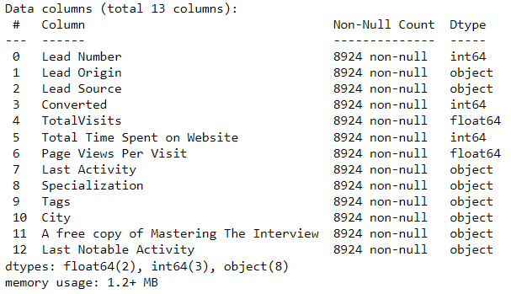

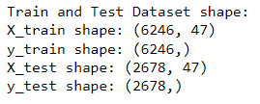
Data Preparation Steps for Modelling
Columns with Binary Values Such as Yes/ No were converted to 1 and 0, like “A free copy of Mastering The Interview”
Dummy Values were created for all remaining 7 columns and then Original Columns were dropped
Train (70%) and Test (30%) Dataset split on random_state 100
For Numeric Columns, Feature Scaling was done using Standard Scaler. On train dataset, Feature Scaling was done using fit_transform and test dataseet, Feature Scaling was done using transform.
Post EDA Final Column List which will be used in Modelling

Slide 14
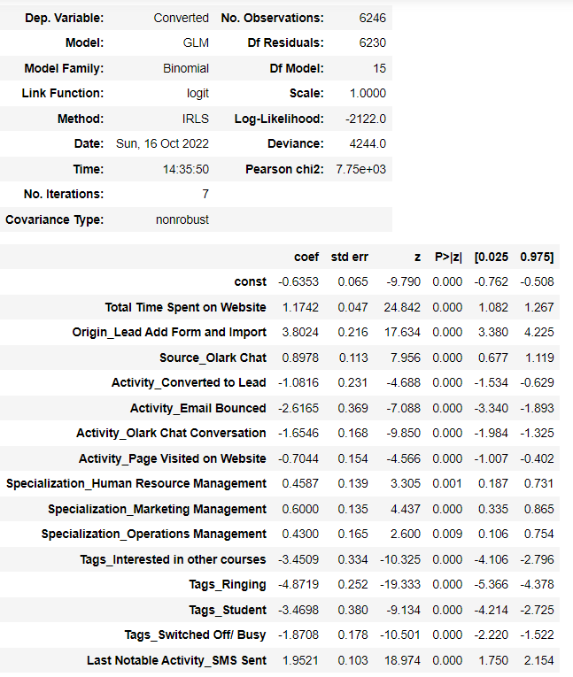
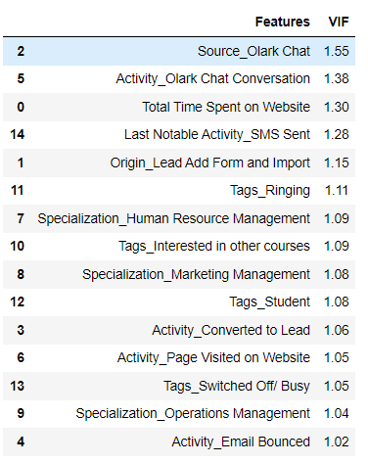

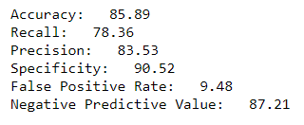
Model Building – Logistic Regression
Model Building is done using RFE with initial 20 variables
Model was built by removing features one by one where p-values are less than 0.010 and VIF Value is less than 2
Predictions on Test Data was performed and compared with the actual Data.

Slide 15
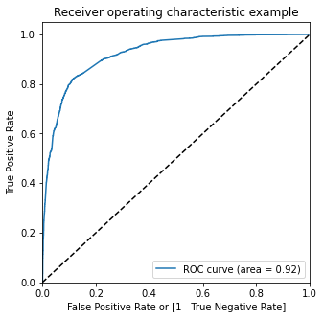
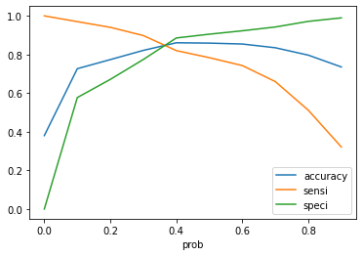

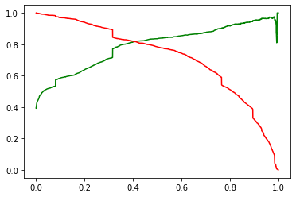
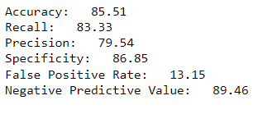
ROC Curve, Optimum Cutoff Point and Precision Recall Curve
Based on our Model, we have got below characteristics:
ROC Curve Value as 0.92
Optimum Cutoff Point as 0.35
Based on this Cutoff Point of 0.35 we have got the following metrics on Train set:
ROC Curve
Optimum Cut Off Point
Precision Recall Curve

Slide 16
Final Recommendation
Based in the above analysis we can conclude on the following points –
1. Lead Source -
a. Olark Chat
2. Last Activity -
a. Olark Chat Conversation
b. Converted to Lead
c. Page visited on Website
d. Email Bounced
3. Total Time Spent on Website
4. Last Notable Activity -
a. SMS Sent
5. Lead Origin -
a. Lead Add Form and Import
6. Tags -
a. Ringing
b. Intrested in other courses
c. Student
d. Switched off/ Busy
7. Specialization -
a. HR Management
b. Marketing Management
c. Ops Management

Slide 17
Thank You

